Slide 1
Advanced .NET Programming I
13th Lecture
Pavel Ježek
pavel.jezek@d3s.mff.cuni.cz
Some of the slides are based on University of Linz .NET presentations.
© University of Linz, Institute for System Software, 2004
published under the Microsoft Curriculum License
(http://www.msdnaa.net/curriculum/license_curriculum.aspx)

Slide 2
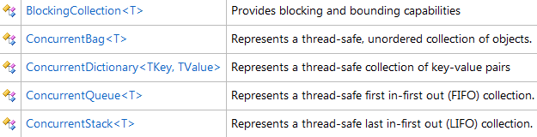
System.Collections.Concurrent

Slide 3
System.Collections.Immutable
ImmutableArray<T>
ImmutableDictionary<T>
ImmutableHashSet<T>
ImmutableList<T>
ImmutableQueue<T>
ImmutableSortedDictionary<TKey, TValue>
ImmutableSortedSet<T>
ImmutableStack<T>

Slide 4
System.Collections.Immutable
var list = ImmutableList.Create();
list = list.Add("first");
list = list.Add("second");
list = list.Add("third");

Slide 5
System.Collections.Immutable
var list = ImmutableList.Create();
list = list.Add("first");
list = list.Add("second");
list = list.Add("third");
var builder = ImmutableList.CreateBuilder();
builder.Add("first");
builder.Add("second");
builder.Add("third");
var list = builder.ToImmutable();

